Slide 1


CORPORATE PRESENTATION
ZHONGXIANG SUPPLY CHAIN MANAGEMENT(ZHEJIANG)CO.,LTD
We'll focus on your shipments. So you can focus on your customers

Slide 2
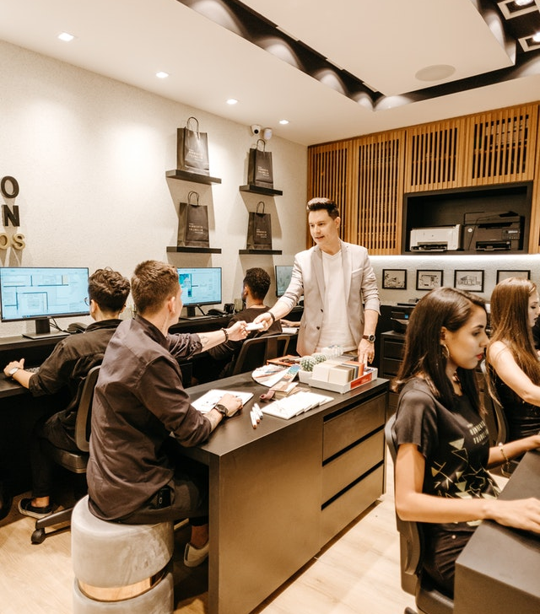
ABOUT US
To offer you the finest logistics solution
Zhongxiang is a company that consists of young and professional members. Its core team of the company was firmly established in 2008.
After more than ten years of development, the company has grown into a comprehensive freight forwarder company, with a strong and flexible team connecting the shipper, customs, distributor and wharf parties.
We are especially experienced in handling the Reefer container, and have won a great reputation in this field.

Slide 3
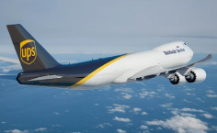
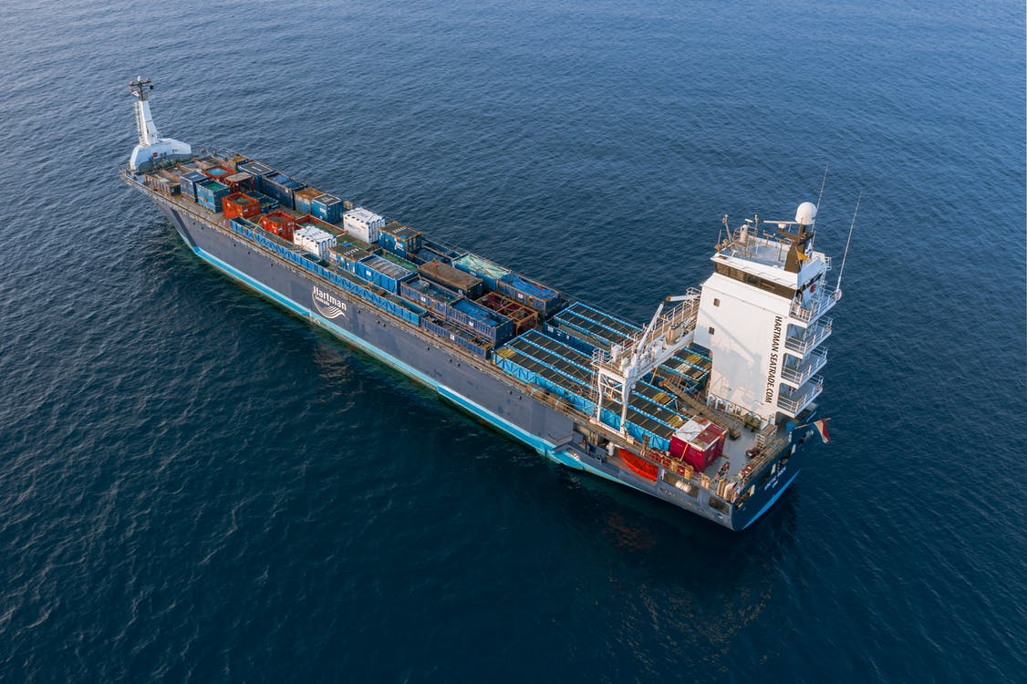

WHAT WE DO
We do 100% for our clients
Air freight
Ocean Freight
Offer flexible solutions
Quick response to meet client needs for more reliable solutions
Your logistics plan will be customized for your unique needs. We offer professional advisory services to help you save money.
We have close relationships with shipping lines to offer you frequent, competitive services.

Slide 4


OUR TEAM
The common goal brought us together.
14 years freight forwarder experience
Young and cooperative members
Flexible schedules for any arrangements
Strong connections between each other
Unique experience in Reefer container
Our core team is established in 2008,and have now developed 8 departments, which coordinate together to work out the best logistics solutions.

Slide 5
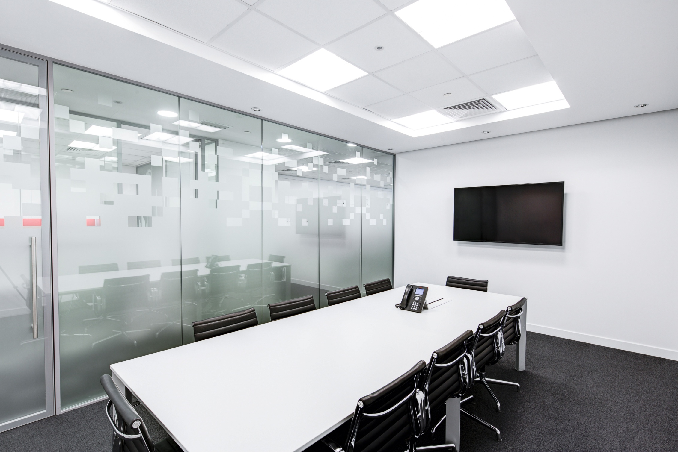
Businesses Scope
One-stop services are available
OOG services
DG services
Reefer Container
Customs clearance
FCL service
Project cargo
FBA services
Railway transport
Air transport
Insurance
Road transport
Warehousing
Free counseling
Tailor for your request
We handle a large scale of international transportation business, including all kinds of container bookings, shipping, warehousing and insurance.etc..

Slide 6
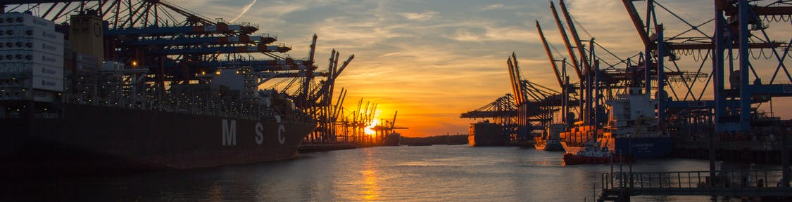




Our advantages
Make your business easier
Ocean&Air freight
Shipping advantage
Competitive price
one- stop service
From any main port in China to any place ,we offer you a flexible service
Special Cargo
One-stop advantage
Reefer cargo
Dangerous cargo
OOG SHIPMENT
Shipping affairs may be tiring and complicated , so we are here to save your time and energy.

Slide 7















CORE BUSINESS-FCL
DDP
Full Container Load service offers you a balance between cost and flexibility.
As a leading Non-Vessel Operating Common Carrier (NVOCC), we have close relationship with shipping lines to offer frequent, competitive services. Providing a trusted and flexible one stop solution for our customers and agents.
Competitive pricing
Space guarantee with quality shipping lines
Offering a choice of service options and schedules
Door services at origin and/or destination
Own warehouses for stuffing and temporary storage
Ensuring quality service and documentation
DDU
EXW
Insurance
Trade Agent
Customs Clearance

Slide 8






CORE BUSINESS-DG handling
DDP
DDU
Class 2, 3, 4, 5, 6, 8, 9
Global range.
DG Warehouse
DG container stuffing
IMO cargo custom declaration
EXW
Insurance
Trade Agent
Customs Clearance

Slide 9
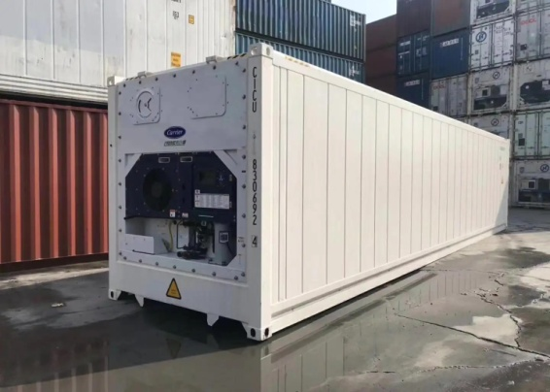
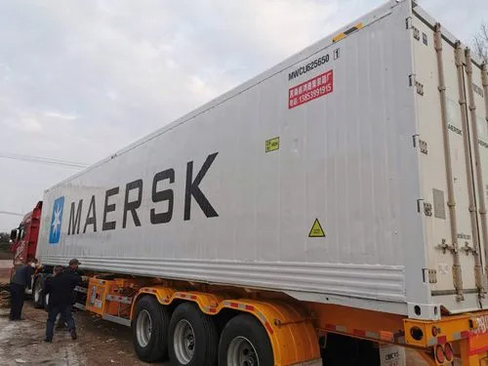
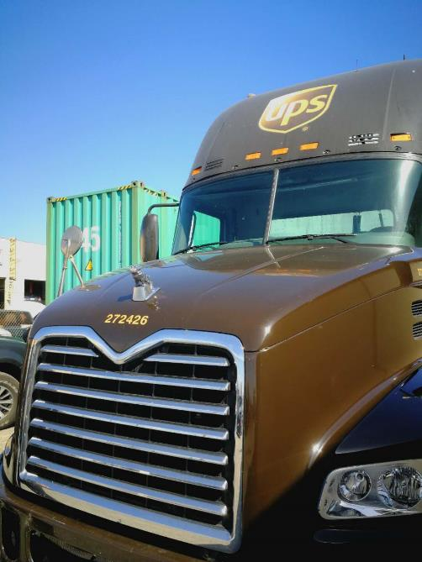
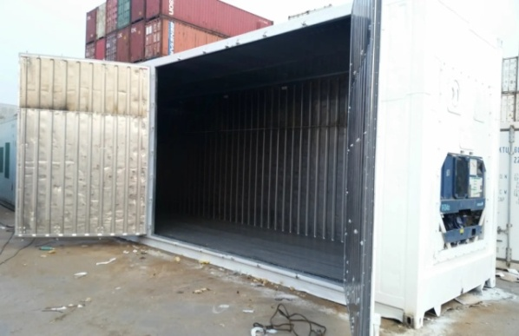
CORE BUSINESS-Reefer Container
DDP
DDU
The Reefer Container is the most experienced business of our company, due to we have been handling this business for years, and we are qualified enough to offer a competitive price and fine service.
EXW
Competitive price
Experienced services
Quick resonse
Ensuring the goods arrive fast
Multiple quotations
Insurance
Trade Agent
Customs Clearance

Slide 10
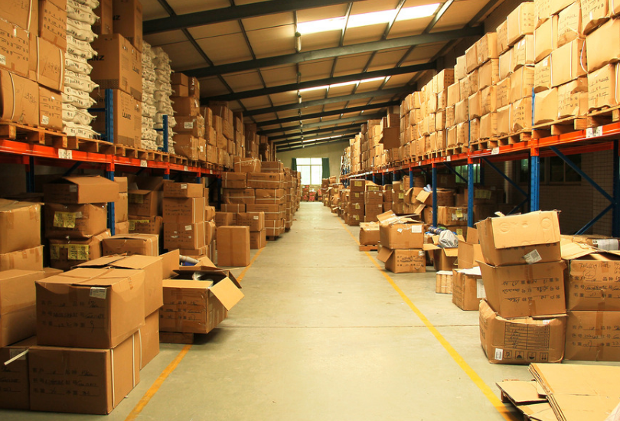
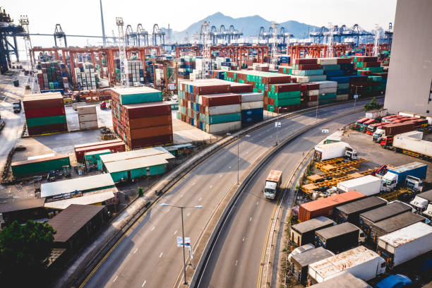
CORE BUSINESS- Warehouse & Trucking
DDP
We can also help our clients to solve the problems related to Warehousing and trucking, satisfy our customers` inbound needs, Customized Specifically for our clients, the inbound logistics services provide integrated solutions for our customers after cargo arrival.
DDU
EXW
Network
International and domestic network
Freight
Long-term agreements with
competitive rate
Insurance
Trade Agent
Service
Cargo tracking system, D2D ,inland
distribution
Clearance
Delivery Order/Customs Clearance etc.
Customs Clearance

Slide 11
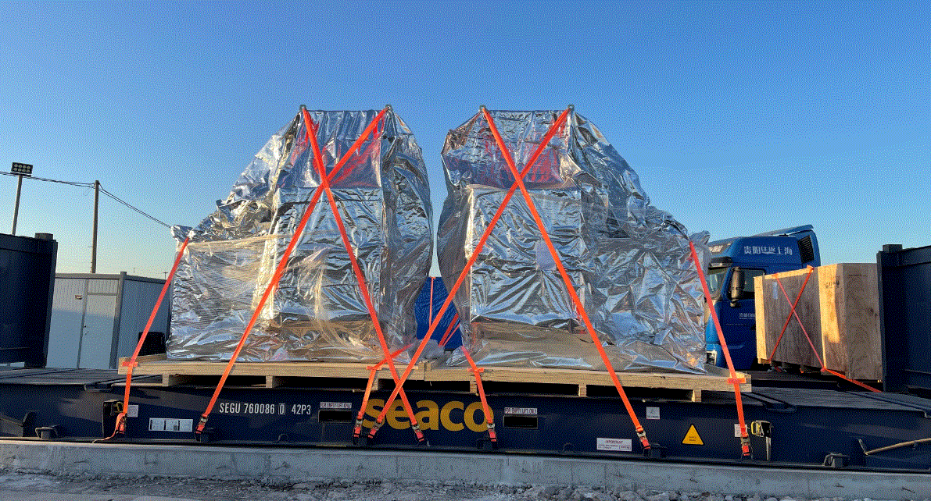
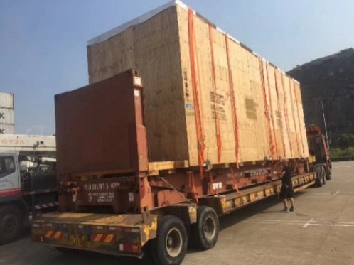
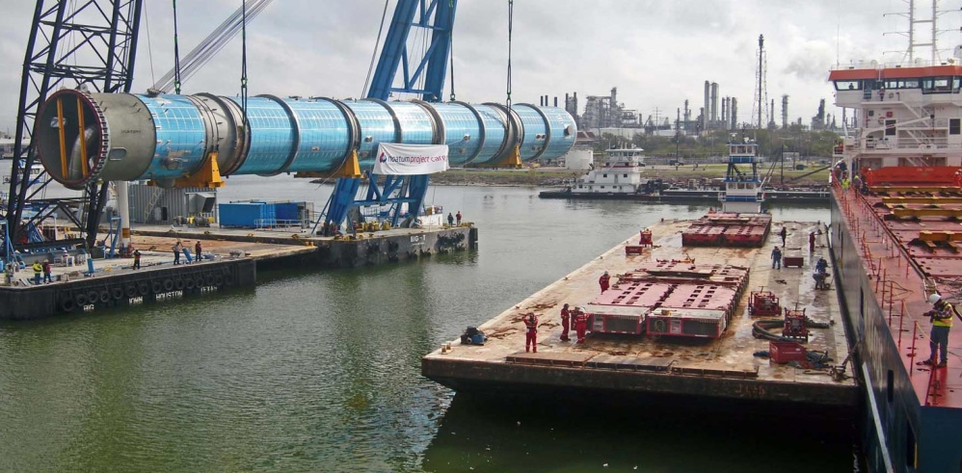
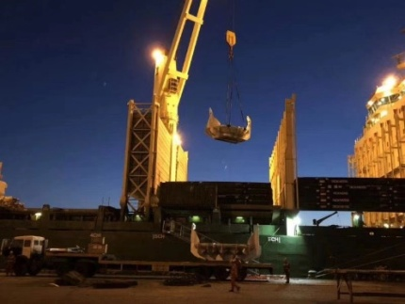
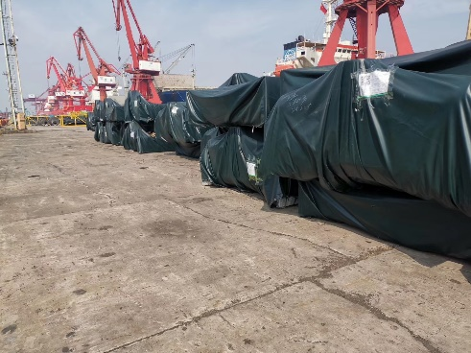
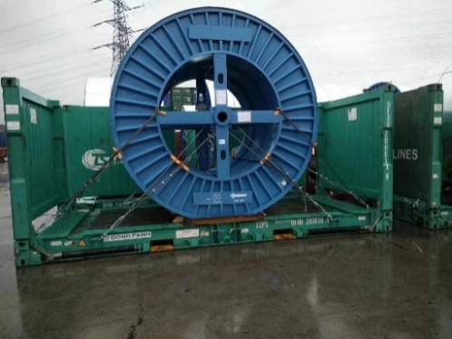
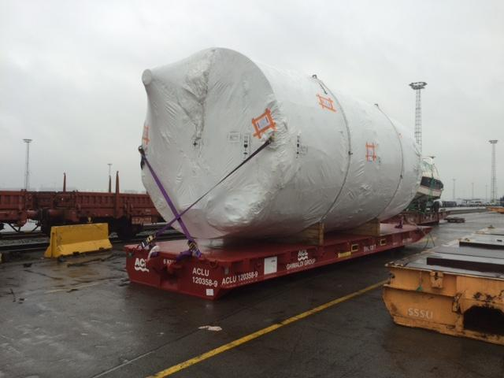
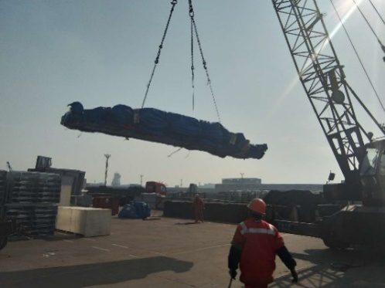
CORE BUSINESS-OOG & PROJECT
Need to ship something that won’t fit inside a container?
Here we can help ! Zhongxiang could handle the most complex transportation and logistics , while ensuring you remain within timelines, budgets and ,safety requirements with transit, coordination of proper packaging of components, required documentation handling, and transportation mode analysis.
We’ll assist you with the regulations you’ll need to consider, and help you ensure the process is smooth sailing from start to finish！

Slide 12
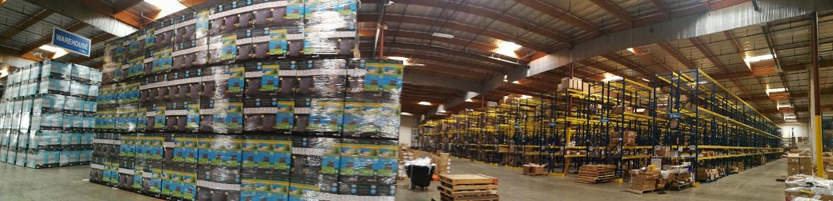
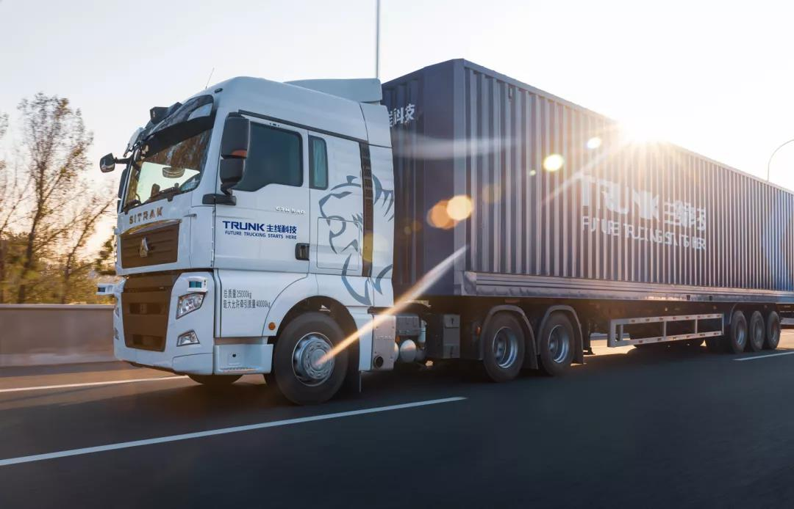
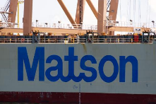

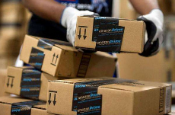

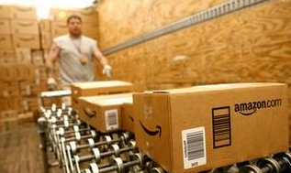
CORE BUSINESS-FBA
We offer one-stop FBA （fulfill by Amazon）service for all the e-commerce sellers to have their products being arranged to Amazon warehouses all around world. We take care of the entire logistic commencement under multi-modal transportation including air, sea, parcel, expedited trucking and etc. Offer various options for different clients and facilitate their selling on Amazon.
Air Freight
Express
Sea Freight
Overseas Warehousing
Sorting Palletizing Labelling
Delivery
Parcel and Trucking

Slide 13


Our Feature
Punctual, fast and sincere
Since we have opened various sailing lines, our company has established a strong network with multiple parties.
Our company is devoted to keeping our service features punctual, fast and sincere.
" Better service for the customer is for the good of the public, and this is the true purpose of enterprise."
– Konosuke Matsushita

Slide 14

COMPANY PHILOSOPHY
With the customer, by the customer, for the customer
Zhongxiang, apply a unique meaning in Chinese, that is, a group of people work together to achieve higher to touch the sky, the Chinese character“Zhong” means a group of people who pursue the same goal.
As a service company, we put ourselves in customers` shoes, we firmly obey the 3-customers` Principles, that is, with the customer, by the customer and for the customer.

Slide 15
THANK YOU
Contacts:
Mason.Hua
Tel:86-17816961413 E-mail: mason.hua@zxscm-zj.com
Skype: mason.hua@zxscm-zj.com
Mob/weChat/whatsapp: 86-17816961413
众翔供应链管理（浙江）有限公司
ZHONGXIANG SUPPLY CHAIN MANAGEMENT(ZHEJIANG)CO.,LTD
ADD: ROOM 1505 COB,CENTURY ORIENTAL PLAZA, NO. 1083 EAST
ZHONGSHAN ROAD, NINGBO CHINA
Hong Kong|Shenzhen|Guangzhou|Xiamen|Shanghai|Ningbo|Qingdao|Dalian|Taipei

