Slide 1
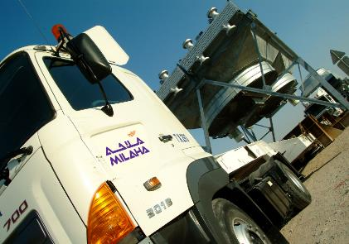
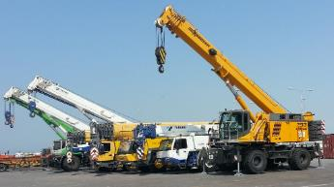
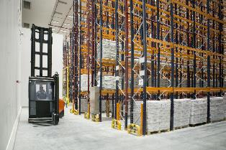
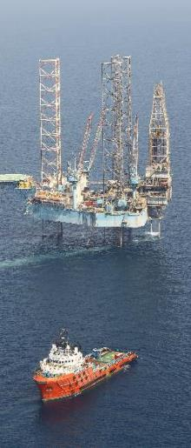
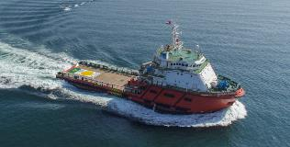

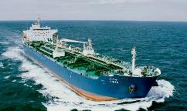
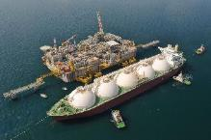
An Introduction to Milaha
December 2018

Slide 2



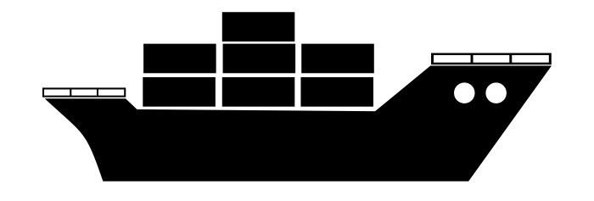


Our History
From 1957
Birth of the first shipping agent in Qatar
From 1982
Expand to ship repair and fabrication in Mesaieed
From 2000
Move forward with Halul offshore and eventual acquisition of Qatar Shipping
From 2011
Strategic transformation and launch of Milaha
Shipping, Offshore, Supply Chain, Logistics, Gas and Petrochem
Milaha – a key contributor to Qatar’s development and welfare
Shipping Agent
Shipping Company
Founding of Qatar National Navigation & Transport Company (QNNTC), the first shipping agent in Qatar
Launch of Marine Transport Services in Doha Port
First fully integrated ship repair and fabrication facility in Mesaieed
Co-founded Qatar Shipping
Co-founded Halul Offshore Services
Merger and acquisition of Qatar Shipping and Halul Offshore Services
Strategic transformation and launch of Milaha
Launch of offices and operations in Singapore, Kuwait, Oman, Pakistan, India, Nigeria, and Iraq
Establishment of QTerminals and Milaha Logistics City

Slide 3






Qatar’s leading Marine and Logistics company
Company Registration No. 1
#1
61
2.5 bn
Qatar’s first ever commercial license
First commercial license in Qatar
Years in operation
Operating Revenue (QAR)
Qatar’s oldest national shareholding company
Widely held by thousands of shareholders with the vast majority being Qatari private investors
2,000+
12
13.6bn
Strong financial position
people
Countries
Net assets (QAR)*
QAR 470 million in net profit in 2017
QAR 18.8 billion in assets for 2017
* Year end 2017 data

Slide 4
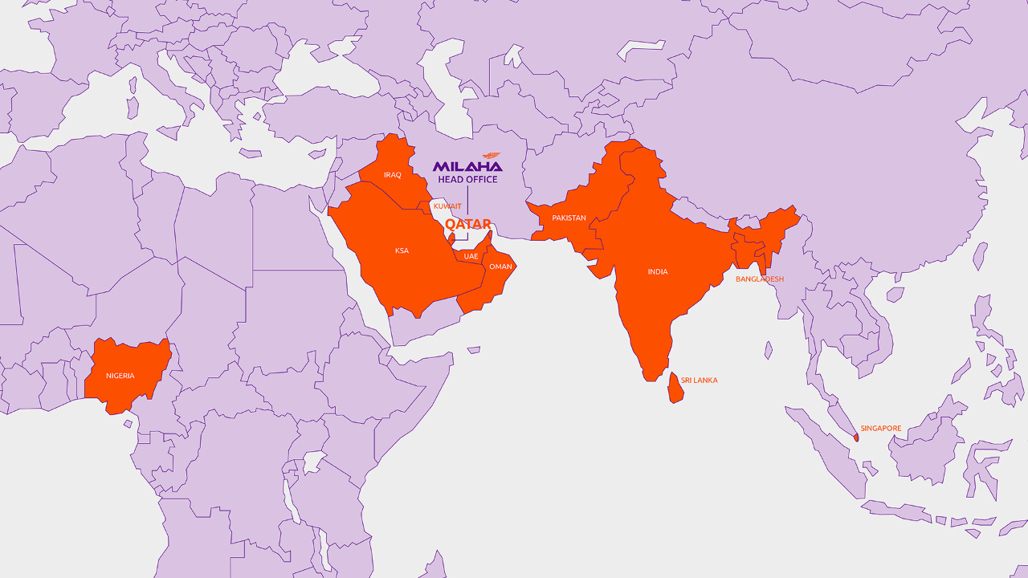
Footprint expanding across Asia and Africa

Slide 5
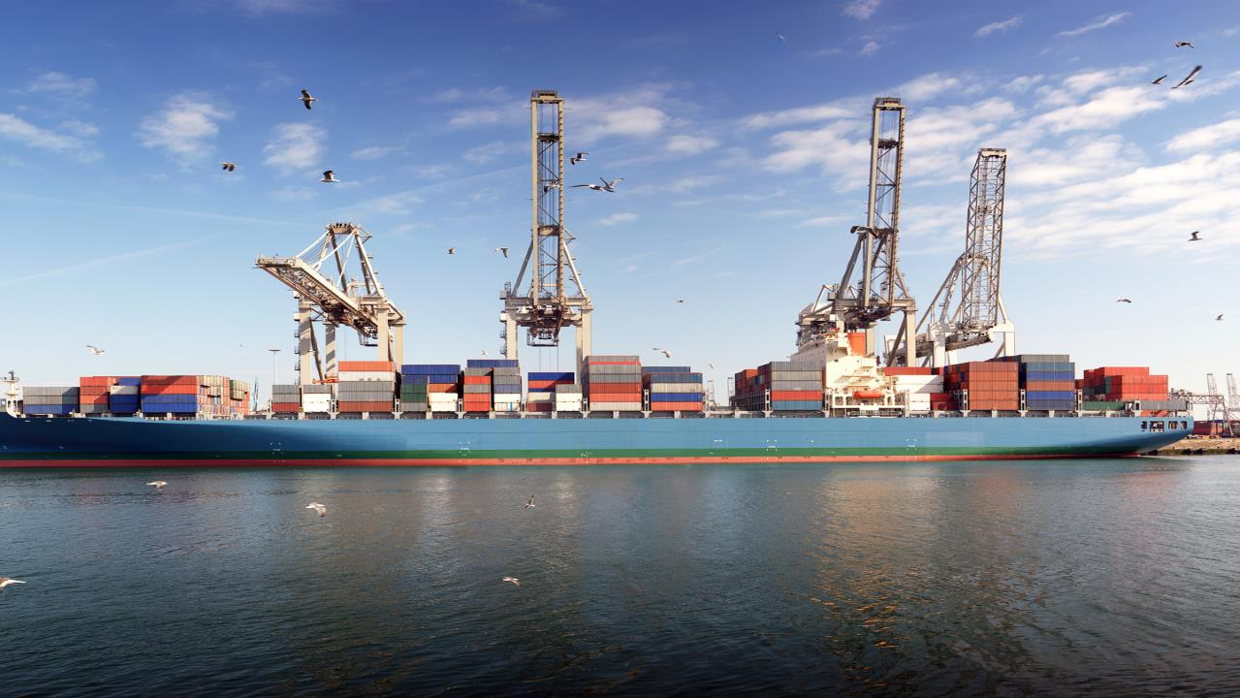

Milaha’s Services

Slide 6





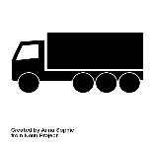
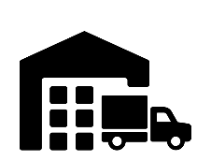



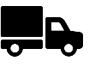

Milaha Maritime and Logistics – Key contributor to Qatar’s supply chain
Offshore services
Gas & Petrochemical shipping
Container Shipping
Port Operations and Services
Shipyard
Shipping Agencies
Road freight
Freight Forwarding
3PL
Warehousing & distribution
Notes:
containers by Nithinan Tatah from the Noun Project
Logistics by Becris from the Noun Project
Boat by Hea Poh Lin from the Noun Project
Port by Petai Jantrapoon from the Noun Project

Slide 7
Our Strategic Pillars
Organized for focus
Milaha
Maritime &
Logistics
Gas & Petrochem
Offshore
Maritime Services
Capital
  Container shipping
  Bulk shipping
  Logistics operations
  Equipment and manpower services
  Terminal management
  Fleet of tankers serving the Oil & Gas industry
  Offshore vessels
  Provide specialized services (subsea support in the form of air and saturation diving, ROV support, & maintenance)
  Shipyard
  Bunkering
  Ship management
  Shipping agencies
  Real estate investments
  Investment portfolio (financial instruments and private equity type activities)
  Trading division (incl. equipment sales & maintenance)
Notes:
containers by Nithinan Tatah from the Noun Project
Logistics by Becris from the Noun Project
Boat by Hea Poh Lin from the Noun Project
Port by Petai Jantrapoon from the Noun Project

Slide 8





Services for our logistics and supply chain customers
Comprehensive supply-chain solutions
We offer synchronized end-to-end solutions for all transport and logistics needs
Our 3PL services include freight forwarding, warehousing and land transport, complemented by ocean transport services
Our NVOCC arm, Qatar Navigation Lines, serves more than 34 destinations and ports in 16 countries across Asia – each covered by a local agent
Our network of agents and associates gives us full control over our clients goods from the point of origin to the point of destination
Line Haul
Logistics in Qatar
Feeder Shipping
Qatar Ports
Hub Logistics/ Warehousing
Foreign Logistics*
Foreign Port*
Transshipment Port*
*Assigned to reliable agent or partner
Notes:
containers by Nithinan Tatah from the Noun Project
Logistics by Becris from the Noun Project
Boat by Hea Poh Lin from the Noun Project
Port by Petai Jantrapoon from the Noun Project

Slide 9
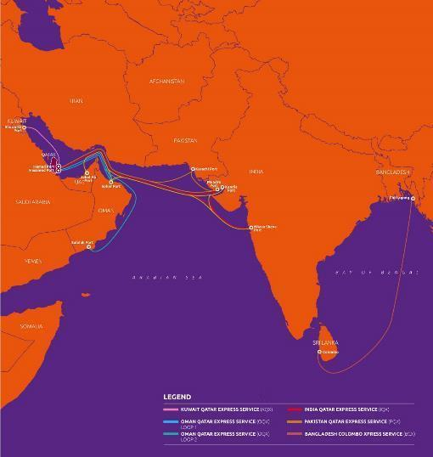
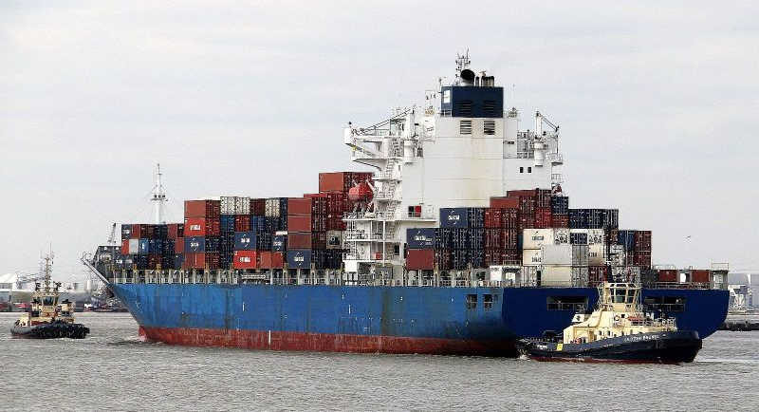
Maritime and Logistics – Container Shipping
Milaha Container Shipping is the only Qatari Container Shipping company and has played a strategic role to support Qatar’s supply chain connectivity.
Our container shipping short haul and feeder network spans across Middle East, Indian subcontinent, Mediterranean and South East Asia. These are served with a combination of owned and chartered ships ranging from 515 TEU to 4,200 TEU
Our liner network presence is across more than 30 countries in Asia and Europe
Projected revenue of over QAR 700 Mn in 2019
Over 60 FTEs spread across various locations
MILAHA CONTAINER SHIPPING NETWORK IN ARABIAN GULF – INDIAN SUBCONTINENT
Notes:
containers by Nithinan Tatah from the Noun Project
Logistics by Becris from the Noun Project
Boat by Hea Poh Lin from the Noun Project
Port by Petai Jantrapoon from the Noun Project

Slide 10
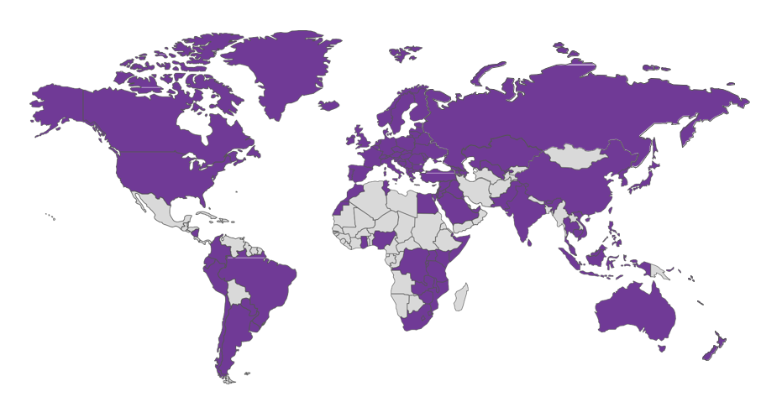
Maritime & Logistics: Logistics
Global Network
Warehouse Facilities
In Progress
TUR
KWT
BAH
10,000m²
DOH
DAH
35,000m²
DXB
10,000m²
15,000m²
OMN
1,500m²
Operations in more than 80 countries and projected revenues of over QAR 230 Mn for 2019
1127 employees spread across locations in Qatar, UAE and Oman
More than 1,000 branch oﬃces, terminals and warehouse facilities
Land Transport Services
Containers
Heavy Lifts (Oversized Cargo)
Break Bulk Cargo
Roll-on / Roll-off Services

Slide 11
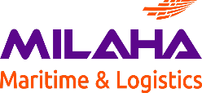
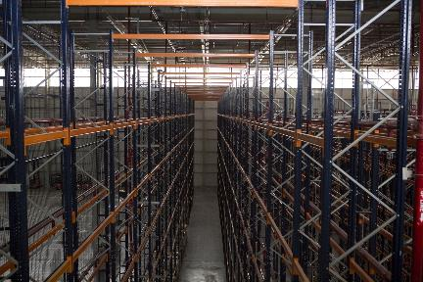
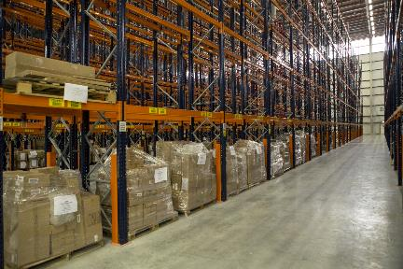
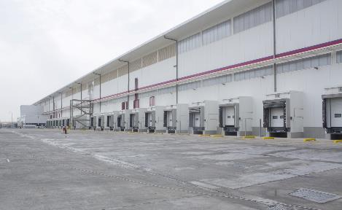
Maritime & Logistics: Warehousing capabilities in Qatar
Phase 1 was inaugurated in 2018, with a 35,000 sqm warehousing facility dedicated to temperature-controlled cargo
Direct access to Qatar’s main transport routes
Flexible warehouse, office and commercial space options available
Superior building and finishing quality
Benchmarked to international HSE standards
Superior infrastructure without filtered gateways by road, for speed and efficiency
Options for value-added services such as Frozen, Chilled and Ambient storage
Logistics City

Slide 12
Maritime and Logistics – Specialized services for Oil and Gas services
Our Specialization
Warehouse and yard management and operations
Supply of Specialized Manpower for Warehouse/Open Yard Operations;
Supply of Equipment for Warehouse/Open Yard Operations;
Yard Operations; Warehouse Operations; Cargo bagging and stuﬃng; Rental of heavy equipment.
Oil & Gas Projects
Milaha is a pioneer in the supply of manpower to oil and gas projects with extensive experience and a loyal customer base.
Project Experience:
RasGas Operations Support Services for the Warehouse and Open Yard Contract;
Qatar Petroleum Yard and Warehouse Operation Contract;
Qatar Petrochemical Company (QAPCO) Bagging and Stuﬃng Contract;
Qatar Fertilizer Company (QAFCO) Bagging and Stuﬃng Contract;
Maersk Oil Yard and Warehouse Operation Contract;
Weatherford Contract.
Land Transport
Equipment rental options are available to meet the speciﬁc needs of the client or project.
Our land transport services include:
Rig and Barge Movement
Milaha possesses the necessary infrastructure and rig moving experience and personnel for all rig relocation projects, with comprehensive packages to accommodate every aspects of rig moves, including all lifting and transportation services.
Yard Operations
Cranes Hire
Supply
of manpower
& Equipment
Rig and Barge Movement
Oil & Gas Projects
Prime Movers
Trailers
Mobile Cranes
Forklift
80+
75+
15
20
Notes:
containers by Nithinan Tatah from the Noun Project
Logistics by Becris from the Noun Project
Boat by Hea Poh Lin from the Noun Project
Port by Petai Jantrapoon from the Noun Project

Slide 13





JVs & partnerships with leading international companies
Joint venture which engages in the trading and maintenance of marine engines, equipment and spare parts in Qatar
Joint venture which provides cargo handling equipment and services in Qatar, specializing in heavy cranes and related activities
Our Trading business is an exclusive agent for world-class manufacturers and international construction equipment companies, marketing their products and providing critical after-sales services.

Slide 14





















Our current client base
Blue chip companies that demand the best services
Notes:
containers by Nithinan Tatah from the Noun Project
Logistics by Becris from the Noun Project
Boat by Hea Poh Lin from the Noun Project
Port by Petai Jantrapoon from the Noun Project

Slide 15
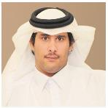
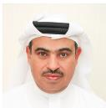
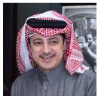
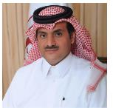
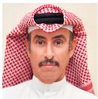
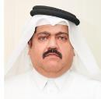
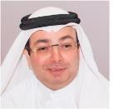
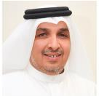
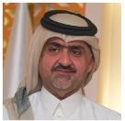
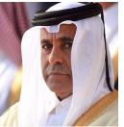
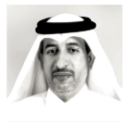
Board of Directors
Our Board Members hold coveted position in the Qatar Government and across the biggest organizations in Qatar:
Chairman of QIB and a Board member in Qatar Insurance Company
Minister of Commerce and Industry, CEO of QNB Group, the Vice-Chairman of Qatar Exchange’s Board Of Directors CEO
CEO of Qatar Gas, Chairman of Qatar Diar Company, and a Board member at Gulf International Company
Minister of State in the Qatari Government, Board member of Qatar National Bank and Qatar Insurance Company, Previous Chief of the Emiri Diwan
President of Ali Bin Ali Establishment, a Board member in Doha Insurance, and Board member in QWEC
Board member in Qatar Manufacturing Industries Company
Vice-Chair & MD Mohamed Hamad Al-Mana Group, Board member of Doha Bank, and Qatar Insurance & Reinsurance Company
President of the Council of Trustees of Hadara, Board of the Qatar Water and Electricity Company.
Member of Board of Directors at Ali Bin Khalifa Al Hitmi
Sheikh Jassim bin Hamad bin Jassim Al-Thani
Chairman
Ali Ahmad Al-Kuwari
Member
Adil Ali Bin Ali
Member
Sheikh Khalid bin Khalifa Al-Thani
Vice Chairman
Saad Mohammad Al-Romaihi
Member
Sulaiman Haidar Sulaiman
Member
Dr. Mazen Jassim Jaidah
Member
Hamad Mohammad Al-Mana
Member
Salman Abdullah Abdulghani
Member
Sheikh Abdulrahman bin Saud bin Fahd bin Jassim Al Thani
Member
Hitmi Ali Khalifa Al-Hitmi
Member

Slide 16
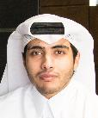
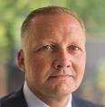
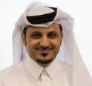
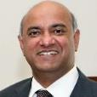


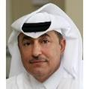
Leadership Team
Abdulrahman Essa Al Mannai
President & CEO - Milaha
Anders Kristensen
SVP Maritime and Logistics
Mohammed Swidan
CEO Offshore
Joseph Coutinho
CEO Gas & Petrochem
Akram Bashir Iswaisi
EVP Finance & Investment
Gautam Bellur
SVP Corporate Development
Saleh Abdulla Haroun
SVP Support Services

Slide 17
Thank you

